Slide 1
Wayfair E-commerce Sales & Profitability Analysis
Case Study | 2024-2025
Tools: Python | PostgreSQL | Power BI

Slide 2
Business Problem
This analysis evaluates historical sales data of Wayfair E-Commerce Company from 2024-2025 to understand changes in sales and profitability, identify products and categories contributing to performance and examine the roles of returns and cancellations.
Business Questions:
How has sales performance changed from 2024-2025?
Which products and categories drive revenue and profitability?
How are returns and cancellations affecting performance?

Slide 3
Data & Analytical Approach
DATASETS
ANALYTICAL WORKFLOW
Raw Data → Data Cleaning → Exploratory Data Analysis → Data Modelling → KPI Definition →
SQL Analysis → Power BI Dashboard → Insights & Recommendations
Dataset | Records | Grain | Purpose
Customers | 3,600 | One row per customer | Customer and acquisition information
Products | 90 | One row per product | Product, category, price and cost information
Orders | 9,207 | One row per order | Order dates, status, payment, discounts and shipping
Order items | 15,409 | One row per product one within an order | Product-level transaction details

Slide 4
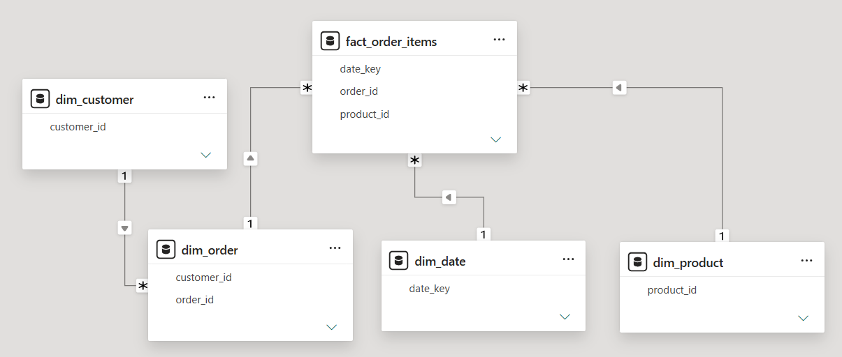
Data Cleaning and Data Modelling
Key Data Cleaning Steps:
Removed 38 exact duplicate order records
Removed 199 order-item records with missing unit prices
Converted data fields to proper data format
Replaced missing discount codes with “No Discount”
Standardized product category names
Validated relationships between datasets

Slide 5
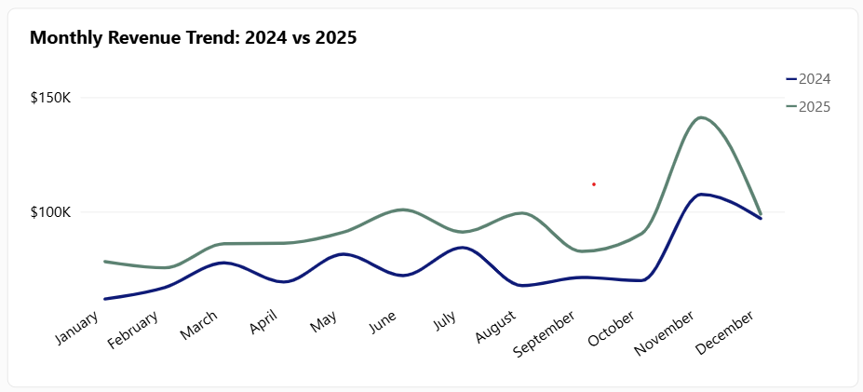
Sales Performance: 2024 vs 2025
Monthly Pattern
November was the strongest month in both years.
Nov 2024 Revenue: $107.5K
Nov 2025 Revenue: $141.1K
Yearly Pattern
Revenue - $926.5K → $1.12M
Profit - $442.4K → $564.8K
Revenue +21.0%
Profit +27.7%

Slide 6
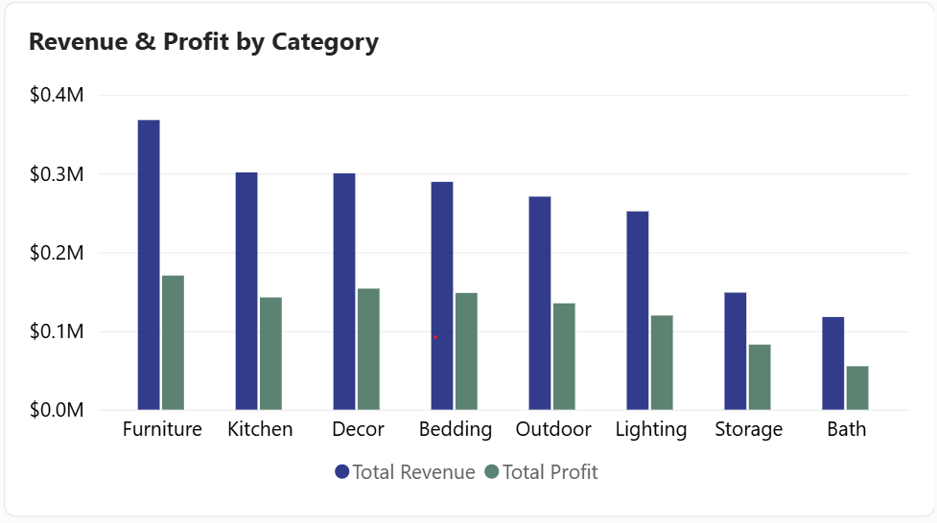
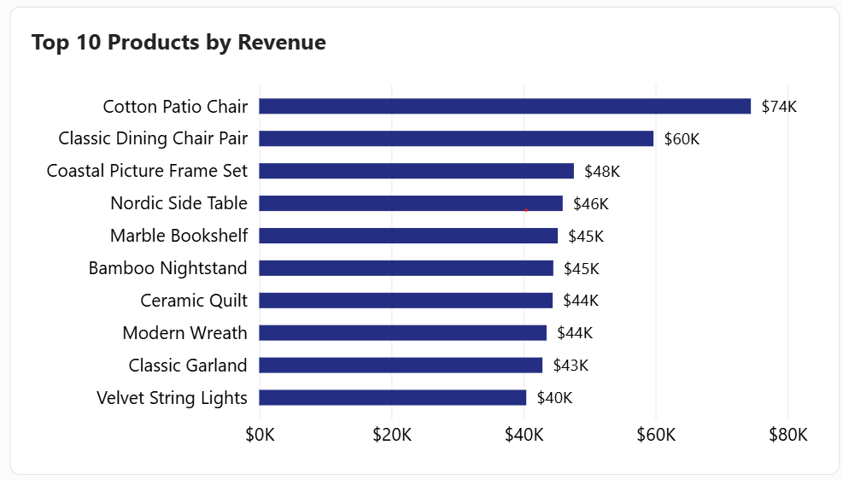
Product & Category Performance
Top Category: Furniture
Revenue: $367.9K
Profit: $170.3K
Top Product: Cotton Patio Chair
Revenue: $74.5K
Profit: $33.3K

Slide 7
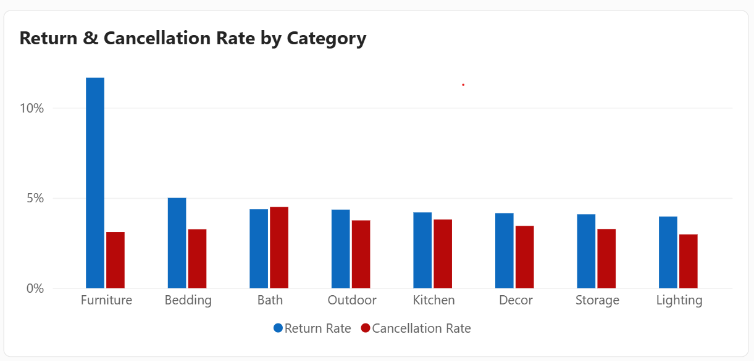
Return & Cancellations
OVERALL STATUS
9,207
Orders
4.42%
Return Rate
407
Returned
3.74%
Cancellation Rate
344
Cancelled
Furniture → Highest return rate: 11.66%
Bath → Highest cancellation rate: 4.50%

Slide 8
Business Recommendations
Monitor category-level profitability: Track revenue alongside profit margin to identify high-sales categories with weaker profitability.
Investigate Furniture returns: Review product expectations, descriptions, quality and fulfilment to understand the 11.66% return rate.
Review Bath cancellation: Investigate the causes behind the ~4.50% cancellation rate and identify potential operational issues.
Evaluate high-revenue, low-margin products: Review pricing, product costs and promotional strategies to improve profitability.
Plan for seasonal demand: Use the strong November sales pattern to support inventory and promotional planning.

Slide 9
Limitations
Dataset represents a simulated e-commerce business scenario
199 order-item records with missing unit prices were removed
Refund amounts and direct financial impact of returns / cancellations were not available
Analysis covers only 2024-2025

Slide 10
Thank You

